Slide 1
PHY-113 TEAM -2 DESIGN AND ANALYSIS OF PENDULUM PUMP
Done by:
Arun Prakash .j (cb.en.u4aie19014)
manjunath (CB.EN.U4AIe19015)
P.s. Sai Ganesh (cb.en.u4aie19044)
Prashanth v.r (cb.en.u4aie19047)
r. Aswin raj (cb.en.u4aie19050)
Siva Prakash Ramesh (cb.en.u4aie19060)

Slide 2





UNDERSTANDING THE GIVEN MECHANISM

Slide 3
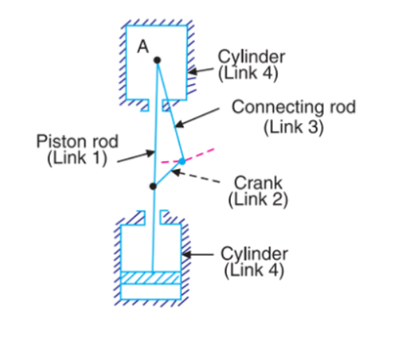
THEORY
Pendulum pump is the fourth inversion of the slider-crank mechanism. In this mechanism instead of the crank, the slider is fixed while the other links are free to move. It has 3 turning pairs and 1 sliding pair.
The connecting rod has an oscillatory motion while the crank undergoes full rotation.

Slide 4
As shown in figure the first link is piston and piston rod, second is connecting rod which is extended beyond its connection to crank, the third link is crank and fourth link is cylinder which is placed vertically and is fixed. When the upward motion is given to connected rod it causes downward motion of piston & vice versa.

Slide 5
DESIGN AND ANALYSIS

Slide 6
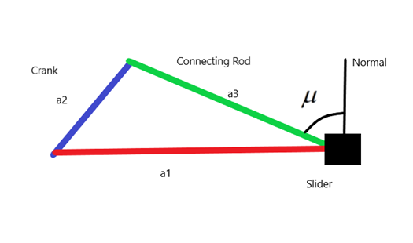

Since the point of contact between the connecting rod and ground lies along the line of motion of a1, this is an inline slider crank mechanism.
Since it is an inline slider crank mechanism the stroke length is two times the length of the crank.
The angle between connecting rod and normal to the slider is called as transmission angle. The formula for maximum or minimum transmission angle is

Slide 7
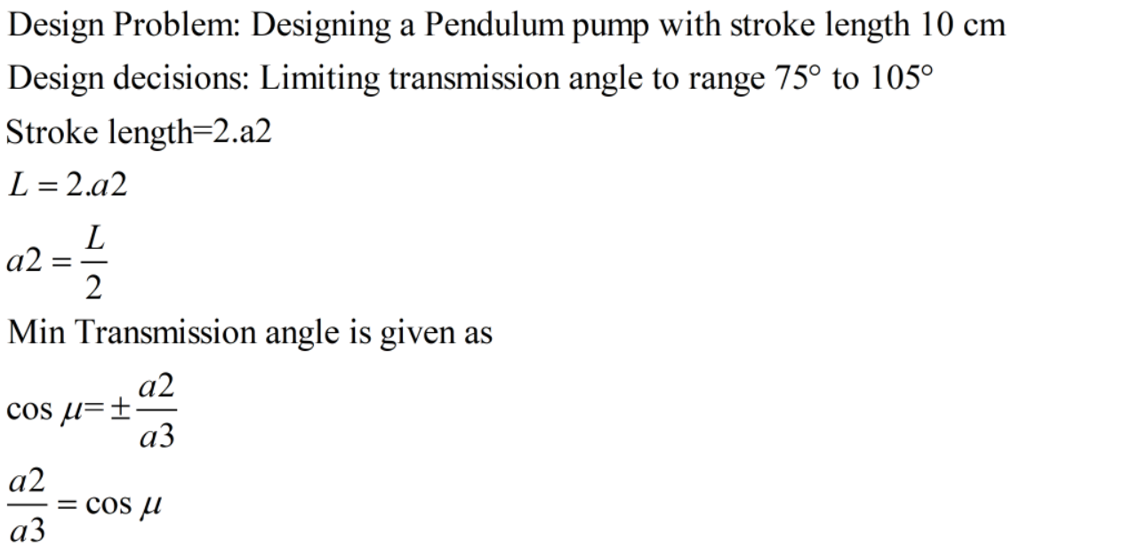
DESIGN OF PENDULUM PUMP

Slide 8
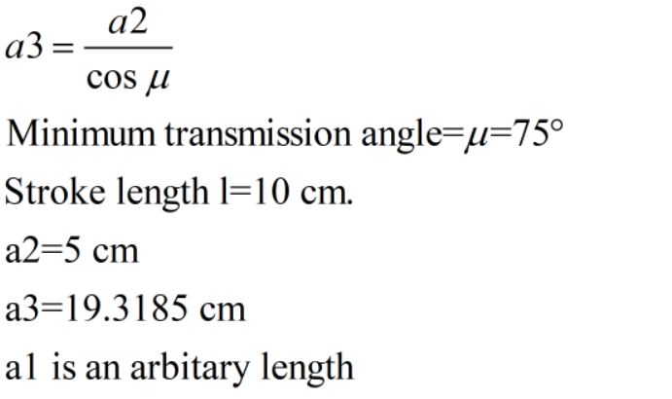
DESIGN OF PENDULUM PUMP

Slide 9


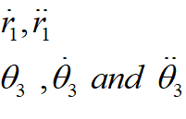
ANALYSIS FOR PENDULUM PUMP
Here the known quantities are:
As link 2 acts as the Driver link , we further get the values of
The unknown quantites are

Slide 10
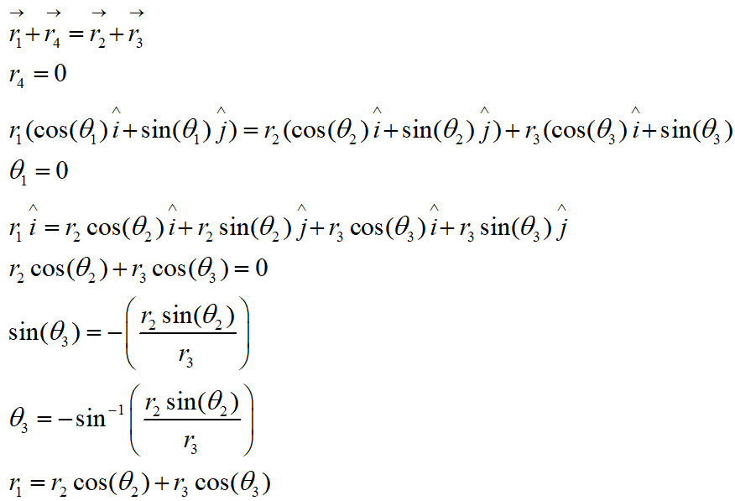
POSITION ANALYSIS

Slide 11
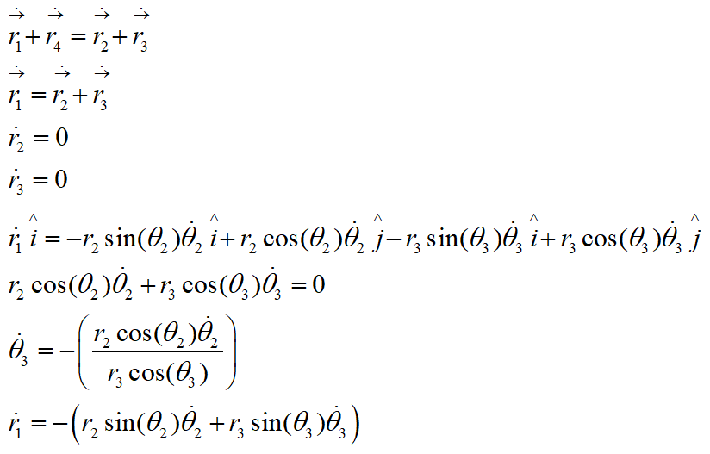
VELOCITY ANALYSIS

Slide 12
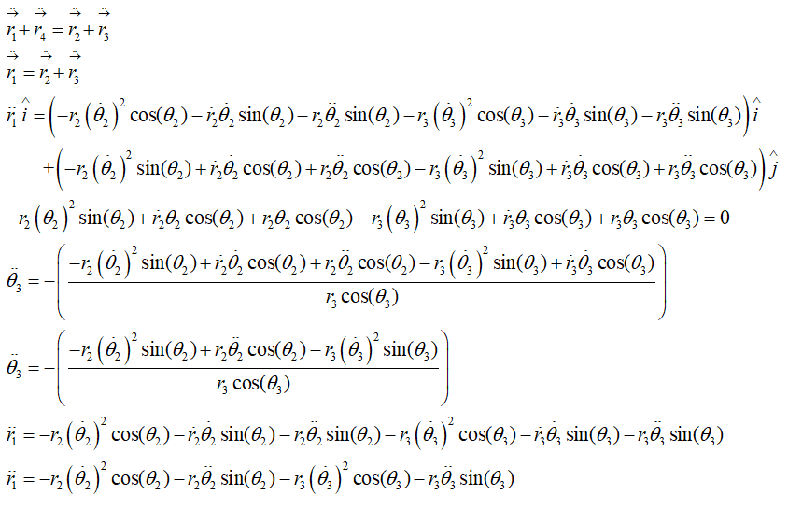
ACCLERATION ANALYSIS

Slide 13
SIMULATION OF THE MECHANISM

Slide 14
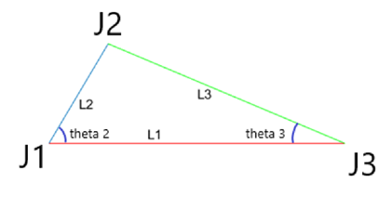
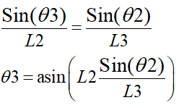
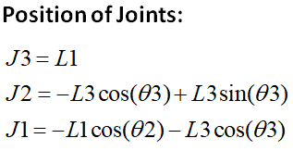
Here Crank is the input. Therefore theta 2 = 0:360 degrees. Then according to sine rule,

Slide 15
APPLICATIONS

Slide 16
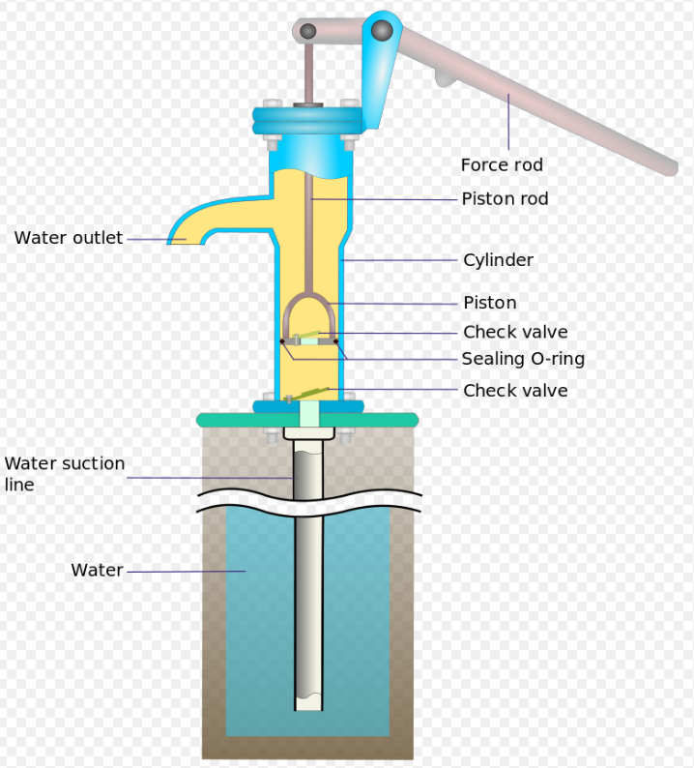
HAND PUMPS
Hand pumps are manually operated pumps; they use human power and mechanical advantage to move fluids or air from one place to another. They are widely used in every country in the world for a variety of industrial, marine, irrigation and leisure activities.
There are many different types of hand pump available, mainly operating on a piston, diaphragm or rotary vane principle with a check valve on the entry and exit ports to the chamber operating in opposing directions. Most hand pumps are either piston pumps or plunger pumps, and are positive displacement.
Hand pumps are commonly used in developing countries for both community supply and self-supply of water and can be installed on boreholes or hand-dug wells.

Slide 17
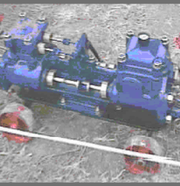
DUPLEX PUMPS
The "direct acting reciprocating steam pump" was invented by Henry R. Worthington in 1840. It is still used today, often powered by compressed air instead of steam.
DUPLEX PUMPS like the one shown here have two steam and two water cylinders. Only one of each is shown, the other cylinders being directly behind these.
Duplex pumps have no "dead spots" because one or the other steam piston is always under force of steam (or compressed air). The two pistons are about 1/4 cycle out of synchronization with each other.

Slide 18
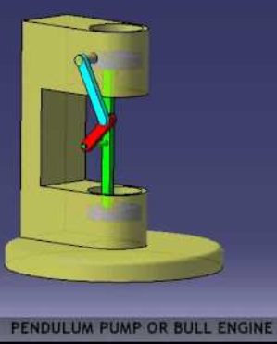
BULL ENGINE
The Bull engine is named after the Cornish engineer Edward Bull, a friend of Richard Trevithick. The Bull Engine at Kew Bridge was built by Harvey & Co in 1856, although it was not put to work until 1859.
A Bull engine differs from a traditional Cornish beam engine in that the steam cylinder is inverted over the pump and thus dispenses with the need for a main beam. This design meant that a Bull Engine took up about half the space of a beam engine of similar pumping capacity and makes the engine safer to operate.

Slide 19
THANK YOU

